Slide 1

VIABILIDAD TECNICO ECONOMICA
para un suministro eléctrico 100% renovable en España
Dr. Santiago Galbete Goyena
Mayo 2017

Slide 2


EVOLUCION SISTEMA ELECTRICO ESPAÑO 2001-2016
Producción potencial renovable
vs demanda = 0.6 España 2007
Ley 54/1997
RD 436/2004
Ley 661/2007
Ley 1/2012
Ley 1/2013
RD 413/2014
Producción potencial renovable
vs demanda = 0.24 España 2007
Producción potencial renovable
vs demanda = 0.24 España 2007
Producción potencial renovable
vs demanda = 0.6 España 2007
Conclusión:
Necesidad de almacenamientos reversibles
Misma solución que la generación nuclear
1

Slide 3


TECNHICAL AND ECONOMIC VIABLILITY of a 100% electric renewable supply in Spain
Spain overview
INSTALLED CAPACITY
ELECTRIC GENERATION
Resources
2016
2016
2015
No gas, no oil, no uranium
Coal quality is very poor : 95% imported
  High potential: Wind, sun, hydro
100.1 GW
255 TWh
51% Renewable
Renewable generation
Wind
22.8%
Electrical isolated country
Solar
41.4%
38.2%
Large Hydro
6.7%
  Connection with France:
  2.8 GW (1.4 GW 2014)
  100% Electric renewable supply is
  the only sustainable option
  (economically and enviromentally)
18.2%
2%
Mini Hydro
1%
Biomass
CHP
Nuclear
6.7 %
7.7%
Coal
58.5%
61.8%
Gas
9,52%
25%
2015 -2017
Non Renewable generation
Last fuel plant (520 MW) has been decommisioned , 2015
9% of the total coal power plants decomissioned (1,4 GW), 2016
A new 854 MW pump hydro plant has been commisioned, 2016
3 GW Wind technologie have been awarded, may 2017
2

Slide 4
TECNHICAL AND ECONOMIC VIABLILITY of a 100% electric renewable supply in Spain
Renewable and storage resource
Pump Hydro storage
Potential Renewable
Power (GW)
Installed capacity
2016 (GW)
Potential: 7 GW
PV on the land
42
Installed: 3.5 GW
Solar
62
(6.7 GW)
PV on the roof,
Madrid 4 GW
20
Batteries
question mark
Wind-Onshore
5
Wind-Offshore
70
Riverland Australia March 2017:
330 MW PV
100 MW/440 MWh Storage
1.1 Million batteries (20% daily production)
Wind
75
(22.9 GW)
Residual Biomass
3
New energetic crops*
2
Rotation of existing forest
1
Biomass
6 (1 GW)
2
RESTRICTION 2
Mini hydro
19
(17 GW)
Large hydro
17
Hydraulic
Binary cycle
4
5 (0 GW)
EGS
1
Geothermal
Total
167 GW RESTRICTION 1
*occupation of the territory

Slide 5
TECNHICAL AND ECONOMIC VIABLILITY of a 100% electric renewable supply in Spain
Condiciones y estrategia para conseguir un suministro 100% renovable en España
Condiciones requeridas
Garantizar el 100% de la demanda eléctrica
El coste del sistema renovable no debe ser superior al del sistema no renovable
Estrategia para conseguir un suministro eléctrico 100% renovable
Priorizar las fuentes renovables no controlables (sol y viento) , tecnologías maduras
Gestionar las plantas hidráulicas de gran potencia para cubrir las deficiencias del sol y viento
Gestionar los almacenamientos reversibles (bombeo) para maximizar el aprovechamiento de las fuentes renovables no controlables (sol y viento)
Controlar plantas de biomasa como fuentes renovables controlables para cubrir las deficiencias del resto de las plantas

Slide 6
TECNHICAL AND ECONOMIC VIABLILITY of a 100% electric renewable supply in Spain
Curva de almacenamiento crítico y zona apta
Recursos limitados (fuentes renovables y almacenamineto)
Se requiere buscar la combinación óptima entre generación renovable y almacenamiento para conseguir un suministro 100% renovable
1.4%
1.2%
8%
1%
6%
0.8%
4%
Reversible storage capacity vs Demand (%)
Reversible storage capacity vs Demand (%)
0.6%
Restrictions 1&2
0.4%
Restrictions 1&2
2%
0.2%
0%
0%
0
0.5
1
1.5
2
Renewable Penetration
0.4
0.6
0.8
1
1.2
1.4
Renewable Penetration
With large hydro
High controllable penetration (scenario 1)
Without large hydro
Low controllable penetration (scenario 2)

Slide 7
TECNHICAL AND ECONOMIC VIABLILITY of a 100% electric renewable supply in Spain
100% renewable electric supply scenarios in Spain
Total 100.1 GW
Total 118.3 GW
Total 132.4 GW
WHEN?
8.3
11.8
9
6.1
17.0
17.0
2.0
49.5
2.0
Non renewable
33.5
Biomass + Geothermal
27.0
3.6
Pumped hydro
0.9
3.6
Hydro
3.5
Mini Hydro
15
Solar
2.1
6.7
50.3
59
Off shore wind
22.9
On shore wind
System 2016
100% renewables
System 2
100% renewables
System 1
A 100% electric system in Spain in 2050 is technically feasible

Slide 8
ECONOMIC VIABLILITY of a 100% electric renewable supply in Spain
LCOE Forecast 2050
LCOE valor tecnologías a 2050
k=8%, i=3,5%
TECHNOLOGY | LCOE 2011 €/MWh | Investment % | O&M % | Resource % | Environment €/MWh | LCOE 2050 €/MWh
Wind Onshore | 74 | -10 | -20 | NA | NA | 65
Wind Offshore | 114 | 0 | 0 | NA | NA | 114
PV on the floor | 71 | -15 | -30 | NA | NA | 58
PV on the roof | 119 | -60 | -50 | NA | NA | 49
STEG Parabolic Trough | 269 | -50 | -50 | NA | NA | 135
STEG Tower with storage | 260 | -65 | -50 | NA | NA | 103
Municipal Solid Waste | 104 | -50 | 0 | 0 | NA | 64
Biomass (straw, pruning, existing forest) | 117 | -20 | -15 | 0 | NA | 107
Biomass (energetic crops) | 196 | -20 | -15 | -30 | NA | 143
Binary cycle Geothermal | 75 | -50 | -50 | NA | NA | 37
EGS Geothermal | 150 | -30 | -40 | NA | NA | 99
Large Hydro | 64 | 0 | 0 | NA | NA | 64
Pumping Hydro | 98 | 0 | 0 | NA | NA | 98
Mini Hydro | 56 | 0 | 0 | NA | NA | 56
Nuclear | 72 | 20 | 0 | 25 | 15 | 94
Gas | 52 | 0 | 0 | 50 | 10 | 91
Coal | 53 | 100 | 0 | 40 | 0 | 73
Cogeneration | 52 | 0 | 0 | 50 | 10 | 91
No environmental
damages are considered
PV on the land LCOE has decreased considerably
Wind and Sun LCOE
are in the same range as nuclear. Bloomberg
2050 is a reference year for many sources
7

Slide 9
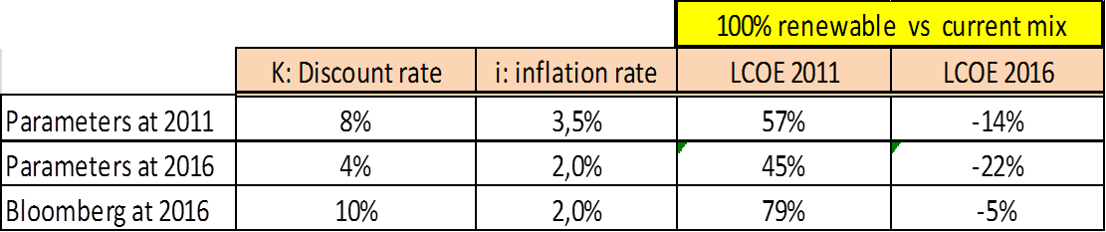
ECONOMIC VIABLILITY of a 100% electric renewable supply in Spain
LCOE 2011 versus 2016
Electricity cost: current mix versus 100% Renevable
2011
i % | K % | Actual €/MWh | 100% Ren. €/MWh | 100% Ren. Vs actual
3.5 | 8 | 68.6 | 107.1 | 156.1%
2050
i % | K % | Actual €/MWh | 100% Ren. €/MWh | 100% Ren. Vs actual
3.5 | 8 | 85.2 | 82.0 | 96.3%
2015
i % | K % | Actual €/MWh | 100% Ren. €/MWh | 100% Ren. Vs actual
3.5 | 8 | 101,5 | 87,1 | 86.7%
Sensibility study: discount and inflation rates
96.3%
A 100% electric system in Spain in 2050 is economically feasible, for any disccount and inflation rates
8

Slide 10
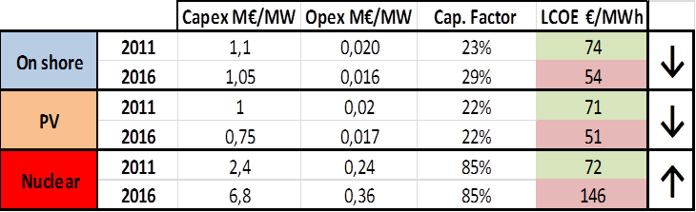
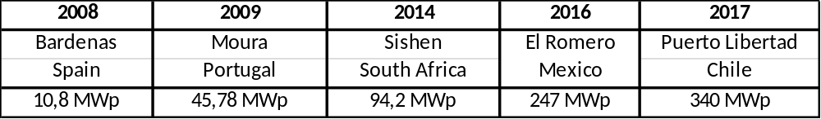
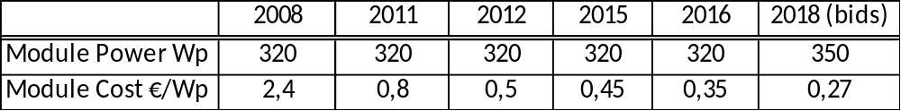
ECONOMIC VIABLILITY of a 100% electric renewable supply in Spain
LCOE 2011 versus 2016,
Wind On Shore, PV and Nuclear LCOE
96.3%
PV, large plants and very high module price decrease, Nuclear CAPEX important increase
9

Slide 11
TECNHICAL AND ECONOMIC VIABLILITY of a 100% electric renewable supply in Spain
Transition Process to a 100% electric renewable system
Energy supply
TWh
Renewable delivered directly to the grid
300
250
Renewable contrallable
200
Large hydro storage
150
Reversible storage
100
No renewable controllable
50
0
No renewable
no controllable
0.3
0.4
0.5
0.6
0.7
0.8
0.9
1
1.1
1.2
RPPR
Non renewable power installed during the transition process
Power
vs
Peak Power
80%
Combined Cycle Power: Controllable
Nuclear Power:
Non Controllable
60%
40%
20%
0%
0.3
0.4
0.5
0.6
0.7
0.8
0.9
1
1.1
1.2
RPPR
10

Slide 12
TECNHICAL AND ECONOMIC VIABLILITY of a 100% electric renewable supply in Spain
Conclusiones
Un sistema eléctrico 100% renovable en España es:
Técnicamente viable. Recurso suficiente y la potencia renovable necesaria esta en el mismo rango que la potencia actual: 100 MW actuales versus 132 GW renovables
Económicamente viable, actualmente el sistema 100% renovable sería del orden de un 13% más económico que el sistema actual
Es el único camino para un desarrollo económico a largo plazo
El almacenamiento es un factor crítico para conseguir un suministro eléctrico 100% renovable: Gran hidráulica y reversible (bombeo y baterías)
El sistema actual dispone de la potencia en plantas convencionales controlables necesaria para el proceso de transición. Estas deberán estar activas prácticamente hasta el final del proceso de transición.
Un suministro 100% renovable es el único camino para un desarrollo económico a largo plazo
El proceso de transición requiere:

Slide 13
VIABILIDAD TECNICO ECONOMICA
de un suministro eléctrico 100% renovable en España
email: sgalbete@acciona.es

